Slide 1

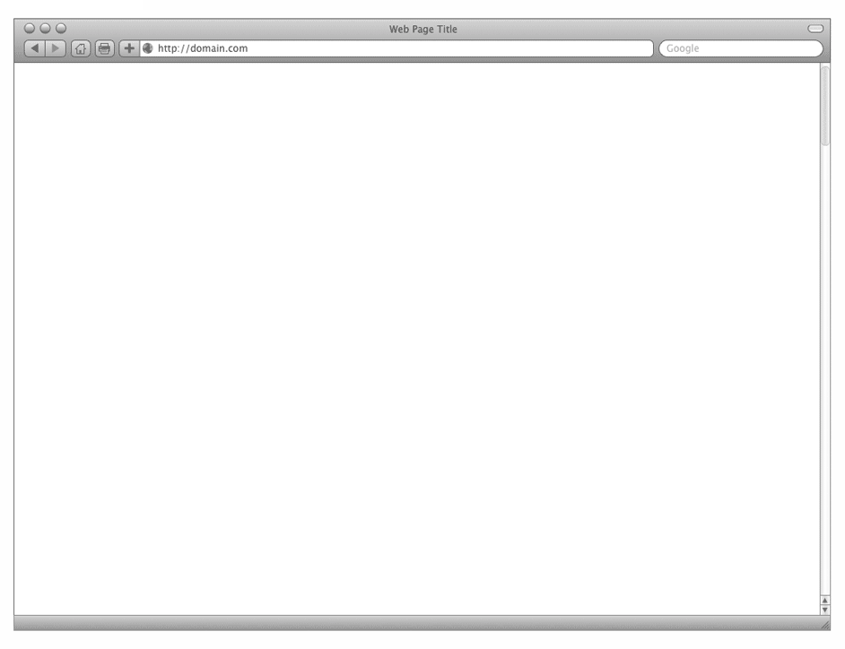
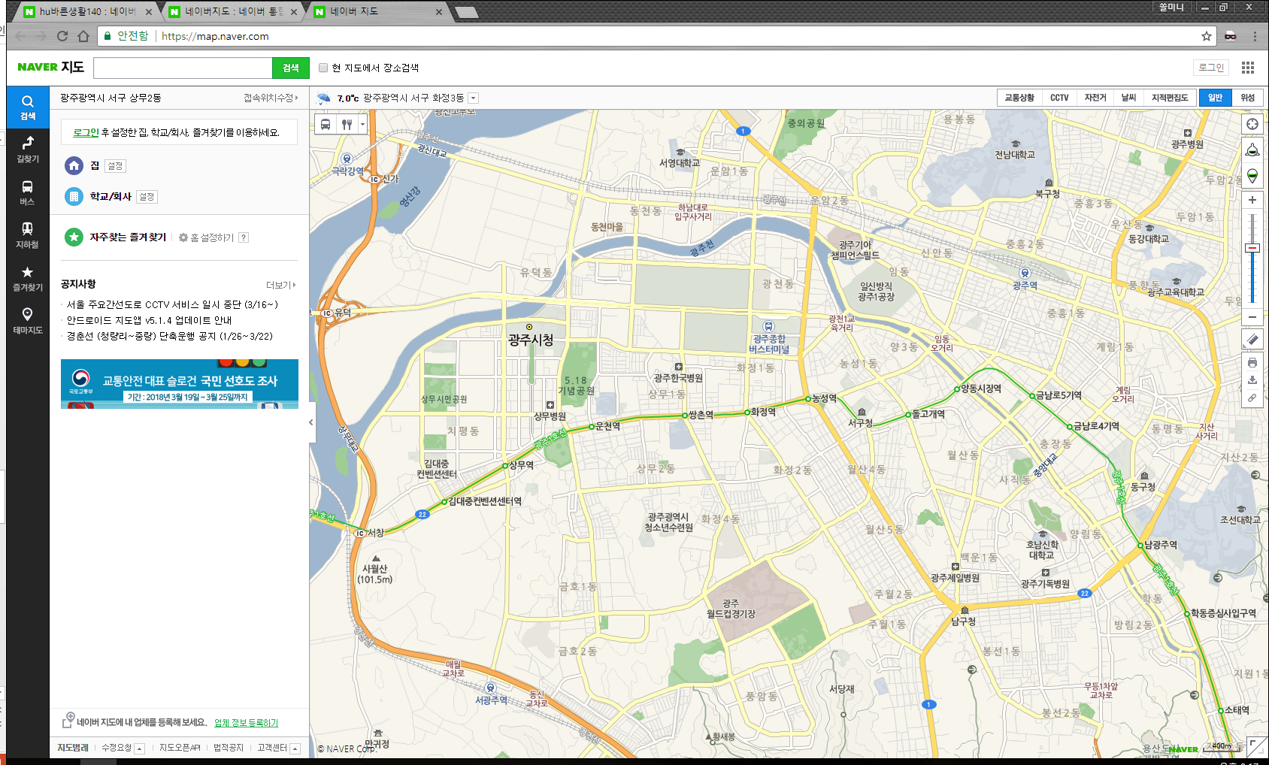
Capstone Design1
Medical web service with public data
Tell me about the best hospital in korea!!
충치
검색
A. XX 치과
B. OO 치과
A
C. XO 치과
B
D. OX 치과
C
D
트위터 실시간 스트리밍 데이터를
분석하여 요즘 언급이 많이 되는
질병 이슈를 시각화
Team | HoLo(Team 3)
Professor | Prof. Hyeonsuk Jeong(Class 2)
Presenter | Solmin Nam
Date | 14-June
Member | Solmin Nam*, Minjung Kim, Saehuin Kim, Soyeong Jin, Soyeon Park

Slide 2
Contents
1
2
Introduce team member & role
Motive for development in Good-
Assessment Hospital Service(GAHS)
A market research about hospital info service
Introduce public data for service
Development environment preparation
for GAHS
3
4
System layout for GAHS
Design of Web page for GAHS
Identify the reliability of the analyzed-
medical data
Introduce HoLo Medical web service
Expectation effect about HoLo
QnA

Slide 3





Introduce HoLo team’s member & role
Solmin Nam
nsm1027@naver.com
https://github.com/Helloworldist
Public data collection and analysis
Using the Rpy2 module
Minjung Kim
kl4314@likelion.org
https://github.com/kl4314
Web page development and
server construction
Saehuin Kim
shms1025@naver.com
https://github.com/huinee
Public data collection and analysis
Soyeong Jin
syoung9606@naver.com
https://github.com/syoung9606
Web page development
Soyeon Park
rkdi100@naver.com
https://github.com/Parksoyeon12
Web page development

Slide 4
Motive for development in good-assessment hospital service
1. There are many hospitals around, but we don’t know which hospital is
A good hospital
There are plenty of advertisements for hospital when we search hospital
in portal site
2. Lack of detailed information about the hospitals
It is troublesome to find out what kind of subjects the hospital that is treat for,
and how to get that traffic information.

Slide 5
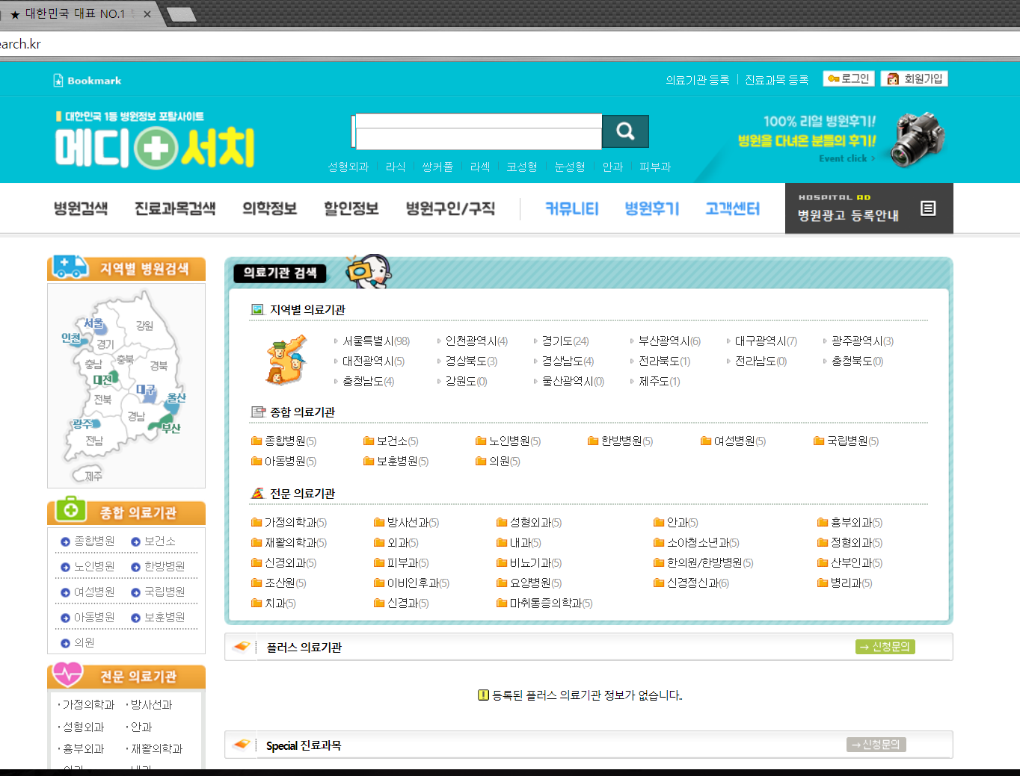
A market research about hospital info service
[Medi Search]
National Hospital Information Service
Include health information
Can check job search of hospital
Available for hospital review

Slide 6
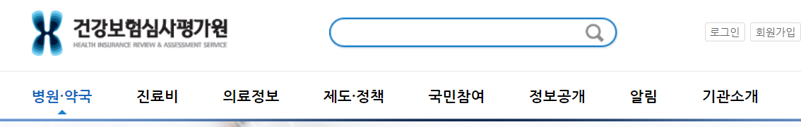
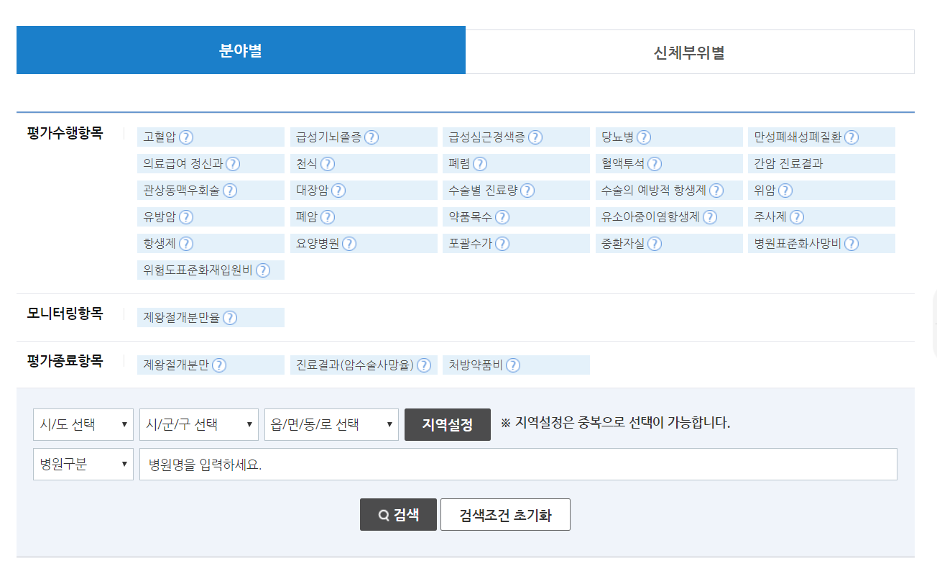
A market survey about hospital info service
[Health Insurance Review
& Assessment Service]
Hospital and pharmacy search services
Search by area and body part
Evaluation grade provided by disease
Providing medical information

Slide 7
A market survey about hospital info service
Result of a market survey, there are a lot of hospital info services,
but we couldn't know which hospital is good.
2. In case of HIRA, we could check assessment grade about disease
by hospital searching. However, additional info is lacked.
Determine the rating by disease and select a hospital with a superior rating through search.
See the doctor's department, details(like traffic info), etc through search.

Slide 8
Introduce public data for service
Hospital info service
Purpose of using : To provide the institution name, address, longitude and latitude,
and telephone number information for the medical institutions retrieved from the web service
Detailed information service by medical institution
Purpose of using : To display facility information, details, and traffic information
for the medical institutions retrieved from the web service
Hospital evaluation result information inquiry service
Purpose of using : To show the evaluation level of hospitals retrieved by users

Slide 9
Introduce public data for service
항목명(영문) | 항목명(국문) | 항목크기 | 항목구분 | 샘플데이터 | 항목설명
ykiho | 암호화된 요양기호 | 400 | 1 | {생략} | 암호화된 요양기호
yadmNm | 병원명 | 150 | 0 | 서울특별시서울의료원 | 병원명
clCd | 종별코드 | 2 | 0 | 11 | 종별코드
clCdNm | 종별코드명 | 150 | 0 | 종합병원 | 종별코드명
sidoCd | 시도코드 | 6 | 0 | 110000 | 시도코드
sidoCdNm | 시도명 | 150 | 0 | 서울 | 시도명
sgguCd | 시군구코드 | 6 | 0 | 110019 | 종별코드
sgguCdNm | 시군구명 | 150 | 0 | 중랑구 | 시군구명
emdongNm | 읍면동명 | 150 | 0 | 신내동 | 읍면동명
postNo | 우편번호 | 6 | 0 | 131865 | 우편번호
addr | 주소 | 500 | 0 | 서울특별시 중랑구 신내로 156 (신내동) | 주소
telno | 전화번호 | 30 | 0 | 02-2276-7000 | 전화번호
hospUrl | 홈페이지 | 500 | 0 | http://www.seoulmc.or.kr | 홈페이지
estbDd | 개설일자 | 8 | 0 | 20110314 | 개설일자
drTotCnt | 의사총수 | 14 | 0 | 188 | 의사총수
gdrCnt | 일반의 인원수 | 14 | 0 | 4 | 일반의 인원수
intnCnt | 인턴 인원수 | 14 | 0 | 30 | 인턴 인원수
resdntCnt | 레지던트 인원수 | 14 | 0 | 57 | 레지던트 인원수
sdrCnt | 전문의 인원수 | 14 | 0 | 97 | 전문의 인원수
xPos | x좌표 | 18 | 0 | 127.09854004628151 | x좌표(소수점 13)
yPos | y좌표 | 18 | 0 | 37.6132113197367 | y좌표(소수점 13)
distance | 거리 | 10 | 0 | 0 | 단위 : 미터(m)
Hospital info service
National Hospital Record Count
: 70288(Std date : 2018.04)
Data volume
: 42.5 MB
Total column
: 21

Slide 10
Introduce public data for service
항목명(영문) | 항목명(국문) | 항목크기 | 항목구분 | 샘플데이터 | 항목설명
Detailed information service by medical institution
plcNm | 공공건물(장소) 이름 | 100 | 1 | 서울성모병원 | 공공건물(장소) 이름
plcDir | 공공건물(장소) 방향 | 100 | 0 | 강남고속버스터미널 남쪽 | 공공건물(장소) 방향
plcDist | 공공건물(장소) 거리 | 10 | 0 | 200m | 공공건물(장소) 거리
parkQty | 주차 가능대수 | 18 | 0 | 0 | 주차 가능대수
parkXpnsYn | 주차장 운영여부, 주차비용 부담여부 | 1 | 0 | Y | 주차장 운영여부, 주차비용 부담여부
parkEtc | 기타 안내사항 | 1000 | 0 | 당일 1회 무료 | 기타 안내사항
noTrmtSun | 일요일 휴진 안내 | 100 | 0 | 전부 휴진 | 일요일 휴진 안내
noTrmtHoli | 공휴일 휴진 안내 | 100 | 0 | 전부 휴진 | 공휴일 휴진 안내
emyDayYn | 주간 응급실 운영여부 | 1 | 0 | Y | 주간 응급실 운영여부
emyDayTelNo1 | 주간 응급실 전화번호 1 | 50 | 0 | 02-2258-2003 | 주간 응급실 전화번호 1
emyDayTelNo2 | 주간 응급실 전화번호 1 | 50 | 0 | 02-2258-2370 | 주간 응급실 전화번호 1
emyNgtYn | 야간 응급실 운영여부 | 1 | 0 | Y | 야간 응급실 운영여부
emyNgtTelNo1 | 야간 응급실 전화번호 1 | 50 | 0 | 02-2258-2003 | 야간 응급실 전화번호 1
emyNgtTelNo2 | 야간 응급실 전화번호 2 | 50 | 0 | 02-2258-2370 | 야간 응급실 전화번호 2
lunchWeek | 월~금 점심시간 | 100 | 0 | 12시30분~13시30분 | 월~금 점심시간
This service is provided based on data reported by each hospital to the Health Insurance Review and Assessment Service
Therefore, the number of columns is different for each hospital.

Slide 11
Introduce public data for service
항목명(영문) | 항목명(국문) | 항목크기 | 항목구분 | 샘플데이터 | 항목설명
addr | 주소 | 500 | 0 | 서울특별시 동대문구 무학로 124 (용두동) | 주소
asmGrd1 | 평가항목 평가등급1 | 4 | 0 | 평가제외 | 급성심근경색증병원평가등급(평가항목코드는 01에 해당)
asmGrd10 | 평가항목 평가등급10 | 4 | 0 | 평가제외 | 골수이식진료량병원평가등급(평가항목코드는 07에 해당)
Hospital evaluation result information inquiry service
Hospital Record Count
with assessment items
among national hospital
: 30459(Std date : 2018.04)
Data volume
: 48.9 MB
Total column
: 35
…
asmGrd9 | 평가항목 평가등급9 | 4 | 0 | 평가제외 | 식도암진료량병원평가등급(평가항목코드는 07에 해당)
clCd | 종별코드 | 2 | 1 | 11 | 종별코드
clCdNm | 종별코드명 | 50 | 1 | 종합병원 | 종별코드명
yadmNm | 요양기관명 | 200 | 1 | 서울특별시 동부병원 | 요양기관명

Slide 12
Introduce public data for service
Encrypted ykiho
Ex) JDQ4MTAxMiM1MSMkMSMkMCMkODkkMzgxMzUxIzExIyQxI
Hospital info Service
Encrypted ykiho
Ex) JDQ4MTAxMiM1MSMkMSMkMCMkODkkMzgxMzUxIzExIyQxI
Each hospital has a unique encrypted symbol
Encrypted symbols are used to identify hospitals
Detailed information service by medical institution
Hospital evaluation result information inquiry service
We can check by Encrypted symbol to...
Facilities & Details
Medical subject info
Traffic info
We can check by Encrypted symbol to...
- Hospital grade rating by disease

Slide 13
Development environment preparation for GAHS
Procedure
1. Operating System | Linux-Ubuntu(18.04)
The default version of Python is 3, and the version optimized for rpy2 usage
2. Language | Python3.6
Mainly using Python for web services and data processing
3. Data processing & analysis | R & Python 3.6-rpy2
Data processing and analysis using the rpy2 module, which makes R functionality available in Python
4. Web server | Python 3.6-Django2.0.4
As an open source web application framework, it has advantages such as reusability of components and ease of development.

Slide 14
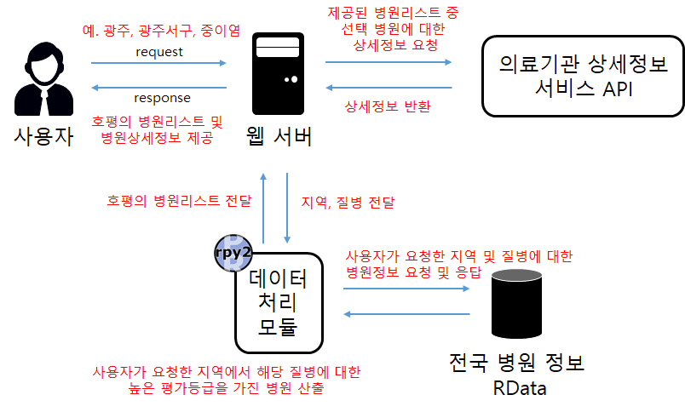
System layout for GAHS
Ex. Seoul, Gangnam-gu, Lung cancer
Symbol for your chosen hospital in provided list
Request
API for Detailed information service by medical institution
Response
Return detailed information about selected hospitals
User
Provide Good Hospital List
Web Server
(Django)
Data Processing
Data collection
(hospital info, evaluation result info)
Return the analyzed data
(Provides a list of the top 10 hospitals analyzed)
Store data
(Save the results from the analysis in Rdata)
Data refining
(Merge the above two data and remove duplicate data)
Clustering
First : City, District
Second : Disease
Data analysis
(Sort by asc order to high grade of disease corresponding to user query)

Slide 15
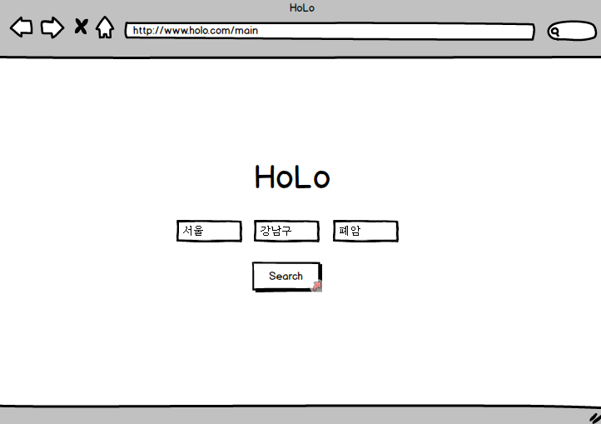
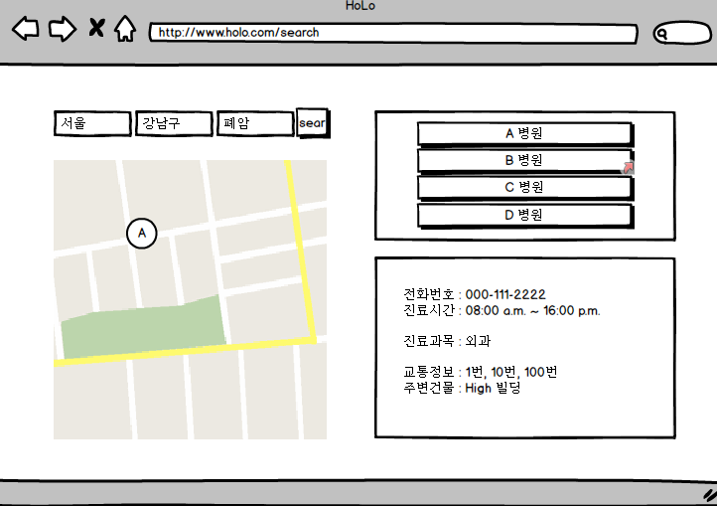
Design of Web page for GAHS
[Initial screen]
[Searched screen]
List of hospitals after analyzing input query as arguments
City
District
Disease
Search for the area and disease you want to search
Displaying map information, detailed information, traffic information, and information about medical care subjects selected from the hospital list

Slide 16
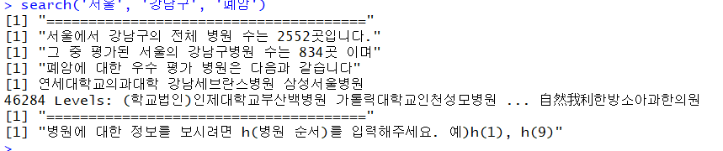
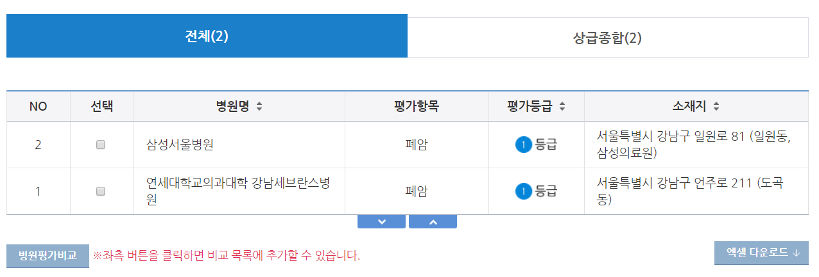
Identify the reliability of the analyzed medical data
Result of analyzed data in R
Result of retrieved data in HIRA

Slide 17
Introduce HoLo Medical web service
Video

Slide 18
Expectation effect about HoLo
1. Hospitals searched through these services may be more competitive than other hospitals
Hospitals with a high evaluation rating are more likely to visit patients than other hospitals, and low hospitals can improve the quality of care to improve the rating.
2. Provide objective hospital assessment information to service users
Since we analyze the information we have assessed by public institutions, it is possible to provide users with unbiased information that is not publicized.

Slide 19
r
QnA
Github : https://github.com/Helloworldist/MediWeb

Slide 20
r
Thank you

